Slide 1

22AIE204 : INTRODUCTION TO COMPUTER NETWORKS Detection & Prevention of ARP Spoofing Attacks in Local Area Networks
Team – 7 AIE - C
G Prajwal Priyadarshan - 214 Kabilan K - 224 Kishore B - 227 Rahul L S - 248

Slide 2
Introduction
Address Resolution Protocol (ARP) is a protocol that enables network communications to reach a specific device on the network. ARP maps Internet Protocol (IP) addresses to a Media Access Control (MAC) address, and vice versa. Most commonly, devices use ARP to contact the router or gateway that enables them to connect to the Internet.
Hosts maintain an ARP cache, a mapping table between IP addresses and MAC addresses, and use it to connect to destinations on the network. If the host doesn’t know the MAC address for a certain IP address, it sends out an ARP request packet, asking other machines on the network for the matching MAC address.
The ARP protocol was not designed for security, so it does not verify that a response to an ARP request really comes from an authorized party. It also lets hosts accept ARP responses even if they never sent out a request. This is a weak point in the ARP protocol, which opens the door to ARP spoofing attacks.

Slide 3
Introduction
ARP spoofing attacks in LANs allow attackers to intercept, modify, or block communication between devices.
ARP lacks message authentication, making it vulnerable to fake ARP replies.
Attackers can associate their MAC address with the IP of another device, like the router.
Detecting and preventing ARP spoofing is essential to protect network confidentiality, integrity, and availability.
Real-time actions, such as alerts or blocking, help secure the LAN from Man-in-the-Middle attacks and other malicious activities.

Slide 4
Problem Definition
ARP is insecure because it does not authenticate messages.
An attacker on the same LAN can send fake ARP replies to associate their MAC address with another device’s IP (e.g., the router).
This allows the attacker to:
Intercept sensitive data (Man-in-the-Middle attack)
Modify or block network traffic
Hijack sessions or credentials
These attacks are hard to detect manually and can compromise the network’s privacy, integrity, and availability.
Therefore, an automated system is needed to:
Detect abnormal or spoofed ARP activity
Prevent such attacks in real-time to secure the LAN

Slide 5
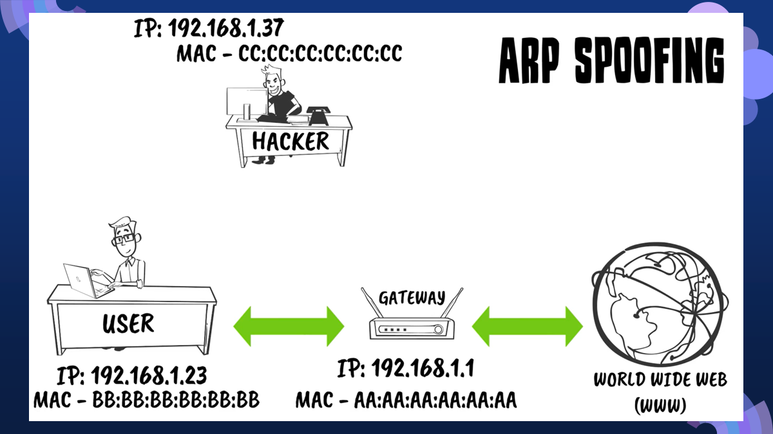
Objectives
Detect abnormal or spoofed ARP activity in the LAN to prevent unauthorized interception or modification of network traffic.
Implement real-time measures to secure the network, maintaining confidentiality, integrity, and availability of data.

Slide 6
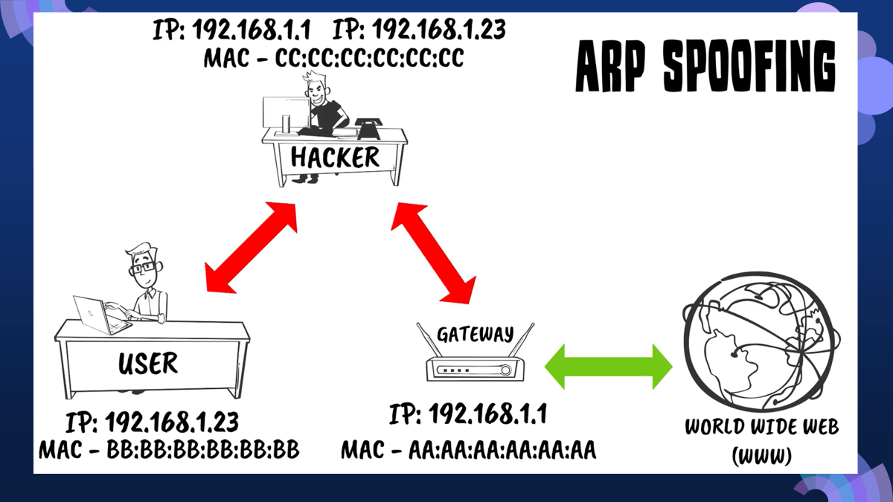
Objectives
Detect abnormal or spoofed ARP activity in the LAN to prevent unauthorized interception or modification of network traffic.
Implement real-time measures to secure the network, maintaining confidentiality, integrity, and availability of data.

Slide 7
Objectives
Detect abnormal or spoofed ARP activity in the LAN to prevent unauthorized interception or modification of network traffic.
Implement real-time measures to secure the network, maintaining confidentiality, integrity, and availability of data.

Slide 8
ARP – Address Resolution Protocol
Address Resolution Protocol is used inside a LAN to find the MAC address of a device when you only know its IP address.
ARP is used to map receiver's IP address to MAC address :
PC (192.168.1.5) wants to talk to the router (192.168.1.1)
PC sends an ARP request - “Who has IP 192.168.1.1? Tell me your MAC address”
The router replies - “192.168.1.1 is at MAC BB:BB:BB:BB:BB:BB”
PC stores this in its ARP table for future use
Weakness in APR :
ARP has no authentication
Any device can send an ARP reply without being asked
If PC receives an ARP reply, it will usually trust it and update the ARP table

Slide 9
ARP SPOOFING
ARP spoofing is when an attacker tricks computers in a network so that their data goes to the attacker instead of the real device.
How Attacker Exploits this
Victim: 192.168.1.5(PC) - MAC-> AA:AA:AA:AA:AA:AA
Router: 192.168.1.1 - MAC-> BB:BB:BB:BB:BB:BB
Attacker: 192.168.1.50 - MAC-> CC:CC:CC:CC:CC:CC
Steps Attacker Takes
Attacker sends fake ARP replies to the victim
--> “192.168.1.1 (router) is at MAC CC:CC:CC:CC:CC:CC” (attacker’s MAC)
Attacker also sends fake ARP replies to the router
--> “192.168.1.5 (victim) is at MAC CC:CC:CC:CC:CC:CC” (attacker’s MAC)
This is known as MITM – Man in the middle attack

Slide 10
What is Wireshark?
Device A – first endpoint (e.g., victim).
Device B – second endpoint (e.g., router/server)
Device C – your device with Wireshark (attacker/observer)
What is Wireshark ?
-> Wireshark is a network protocol analyzer — basically, a tool that lets you capture and examine the data packets moving through a network in real time
-> Used for monitoring network between 2 devices
-> Your device must be placed so it can see A<->B traffic by doing ARP Spoofing so, all traffic passes through it.
Why Wireshark (Relevance to ARP Spoofing) ?
Helps detect anomalies in ARP traffic (e.g., several IPs with same MACs).
Supports forensic analysis after an attack.
Useful for testing effectiveness of ARP spoofing prevention mechanisms.

Slide 11
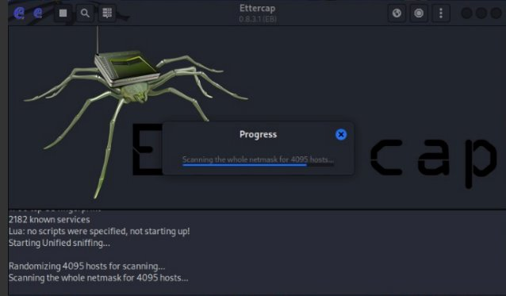
What is Ettercap & Use of it
Ettercap is an open-source network security tool mainly used for Man-in-the-Middle (MitM) attacks on local area networks.
What Ettercap Does -> Performs ARP spoofing/poisoning to trick devices into sending traffic through the attacker’s system.
Captures (sniffs) all network packets passing through the attacker.
Modifies packets in real time if needed.
Supports both active attacks (altering traffic) and passive sniffing (just observing traffic).
Works on many protocols: HTTP, FTP, Telnet, etc.

Slide 12
Methodology
A. Network Environment Setup
Simulate a LAN using virtual machines and vicitms.
Connect some normal devices (real users) and one attacker device in the same network, so the attacker can pretend to be someone else and trick the others — just like ARP spoofing happens in the real world
B. Detection Techniques
Monitor ARP tables for frequent or unusual MAC-IP mappings.
Use tool like Wireshark to watch ARP traffic and identify anomalies

Slide 13

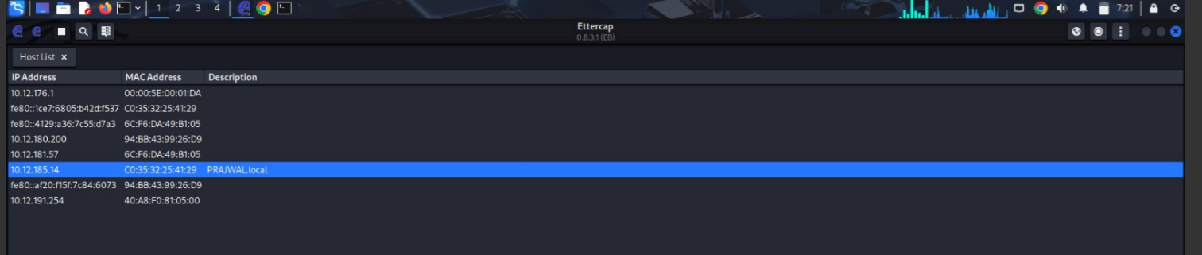
Simulating ARP spoofing in Kali LInux
Enable IP Forwarding (so Kali forwards packets, not just drops them):
Open Ettercap , start sniffing and scan for hosts

Slide 14
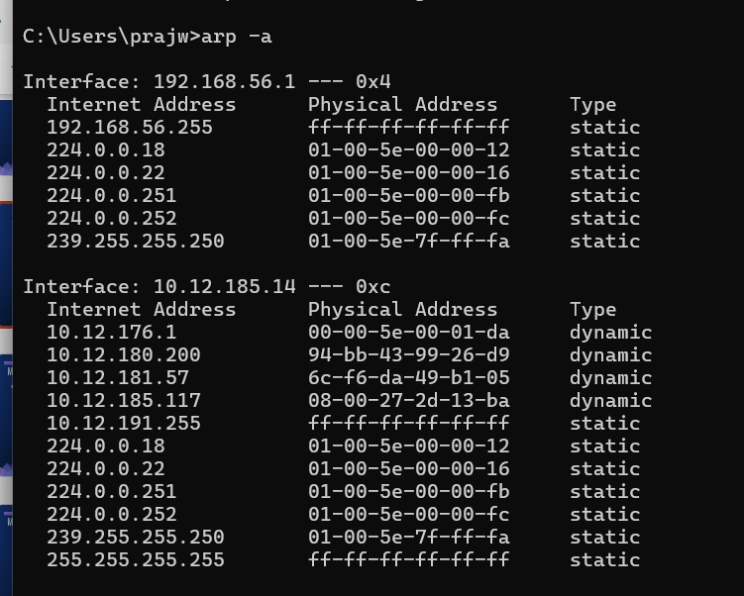
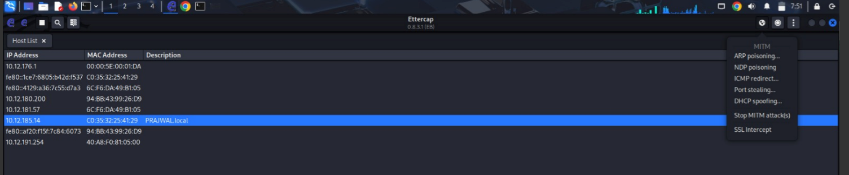
3 – check arp table in victim
4 - we will start ARP poisoning

Slide 15
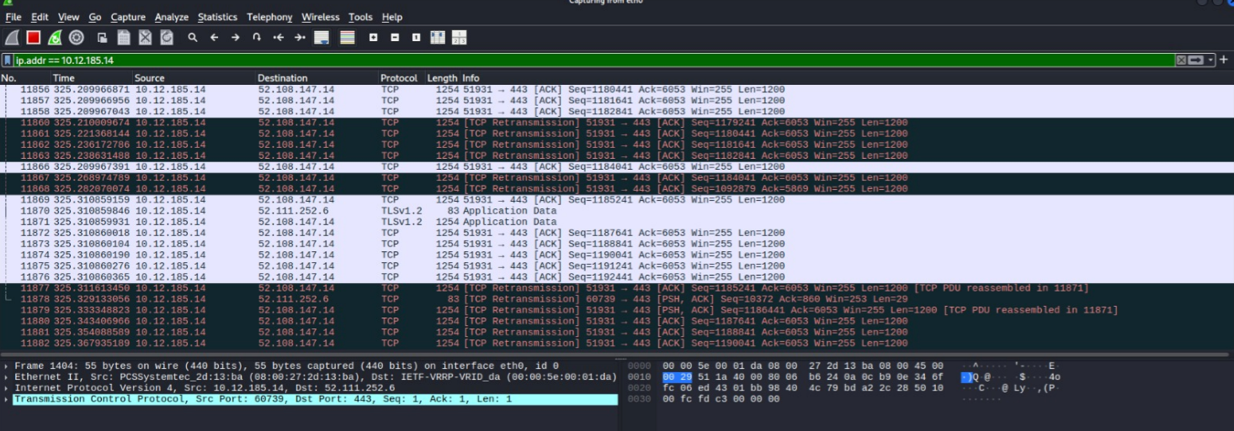
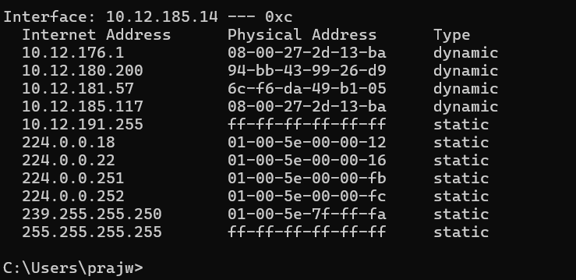
3 – Capture on Wireshark
In Kali
4 – check arp table now in victim

Slide 16
Methodology
C. Prevention Techniques
Use of VPN
Virtual Private Networks (VPNs) provide an encrypted tunnel for internet communication.
When a VPN is used, all online activities and data transmissions are encrypted, making it significantly harder for attackers to execute ARP spoofing.
Even if an attacker successfully redirects your traffic via ARP spoofing, VPN encrypts all data.
The attacker cannot read or modify the encrypted data, making ARP spoofing largely ineffective.
Static ARP entries
A manually configured IP-to-MAC mapping that cannot be altered automatically by ARP responses.
Creating static ARP entries for frequently communicating hosts can provide an additional layer of protection
Static ARP entries act like a “lock” on IP-to-MAC mapping. Attackers cannot trick the device into sending traffic to their MAC because the mapping is immutable

Slide 17
Methodology
D. Testing and Evaluation
First, they run the spoofing attack on the network without security tools → measure how badly it succeeds.
Then, they enable the proposed defenses.
Run the same attacks again.
Compare results

Slide 18
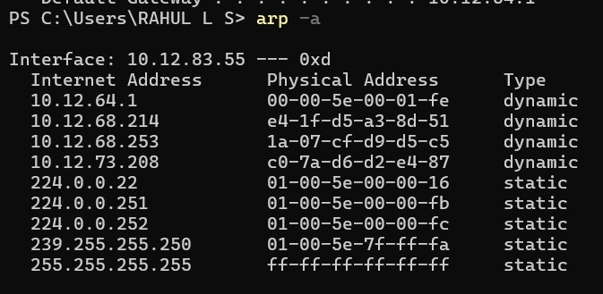
Preliminary Results
Router's IP & MAC before ARP Spoofing

Slide 19
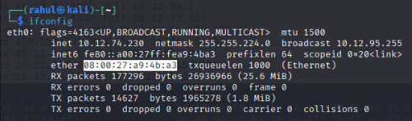
Preliminary Results
Attacker's MAC address

Slide 20
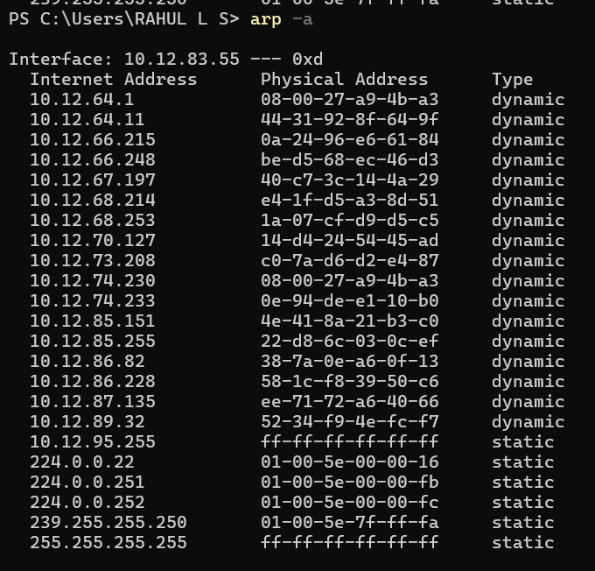
Preliminary Results
Router's IP & MAC after ARP Spoofing

Slide 21
Goal & Predicted Output
Practical Demonstration : Perform an ARP spoofing attack in a virtual LAN Ettercap, then capture and study how the attacker can intercept or change the communication between devices in wireshark.
The goal is to
Intercept or modify data going between two devices on the network.
Capture packets and study how an attacker can watch or tamper with communication.
​
​Expected Results​ :
Show that ARP poisoning is a major threat in LANs.
Demonstrate how attackers can intercept or block data.
Analyze how network traffic can be exploited.
Recommend simple methods to prevent such attacks.
Enhance the overall security of LAN communication.

Slide 22
Thank You !

